Slide 1

DSC680 Project 3 Walmart Sale Prediction
Dhiraj Bankar
Notes:
Hi all welcome to last project of this course I’m so excited submitting this project and today’s last day of Master’s and my master will be done I am so happy OK so no further delays let’s begin so this is Dhiraj Bankar and I’m going to present her project three the prediction model for Walmart sells for 46 stores.

Slide 2
Outline
Project Scope
Research Questions
Intended Methods
Data Overview
EDA
Model Fitting
Notes:
As part of this presentation I’m going to present what is the school pop my project what is the research question or what all matters I am use data overview data Exploratory data analysis and model fitting.

Slide 3
Project Outline
Dataset Location:-
https://www.kaggle.com/rutuspatel/retail-analysis-with-walmart-sales-data
Dataset Information:-
The dataset is related to Walmart sales for 46 stores. Dataset have 8 attributes
Store - the store number
Date - the week of sales
Weekly_Sales - sales for the given store
Holiday_Flag - whether the week is a special holiday week 1 – Holiday week 0 – Non-holiday week
Temperature - Temperature on the day of sale
Fuel_Price - Cost of fuel in the region
CPI – Prevailing consumer price index
Unemployment - Prevailing unemployment rate

Slide 4
Research Questions
Question-
Predict the impact on sales due to various factors like temperature, holidays, weekends and unemployment.
Benefits: -
The benefits of analyzing this data include: -
I have a very soft corner it through the industry because I got most of my experience in retail industry about six years of my career so I found this dataset and I started creating model.
I am pretty confident about this model as we have sufficient data available for production. And this model will be definitely ready to available for any Walmart store or any similar retailer who has similar kind of data they can definitely use it.

Slide 5
Intended Methods
Since it’s a predictive model, the methods I am going to use are: -
Multiple linear regression
Polynomial regression
Random Forests regression

Slide 6
Dataset Overview
This is the historical data that covers sales from 2010-02-05 to 2012-11-01.
Store - the store number
Date - the week of sales
Weekly_Sales - sales for the given store
Holiday_Flag - whether the week is a special holiday week 1 – Holiday week 0 – Non-holiday week
Temperature - Temperature on the day of sale
Fuel_Price - Cost of fuel in the region
CPI – Prevailing consumer price index
Unemployment - Prevailing unemployment rate

Slide 7
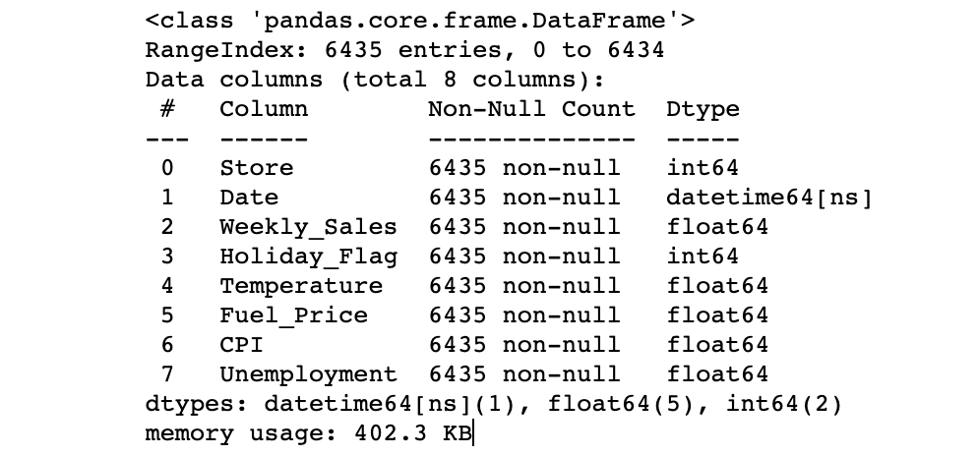
Dataset Summary

Slide 8
EDA
Sales by store
Notes:
Clearly, from the above graph, it is visible that the store which has maximum sales is store number 20 and the store which has minimum sales is the store number 33.

Slide 9
Sales Distribution of store no 14
Notes:
Which store has maximum standard deviation? i.e. the sales vary a lot. Also, find out the coefficient of mean to standard deviation. Thus, the store which has maximum standard deviation is store number 14.

Slide 10
Sales Distribution of store no 35
Notes:
Thus, the store which has maximum coefficient of mean to standard deviation is store number 35.

Slide 11
Quarterly Growth rate in Q3’2012
Notes:
3) Which store/s has good quarterly growth rate in Q3’2012 ?¶ Clearly, from the above graph, it is evident that the store which has good quarterly sales in Q3’2012 is store no. 4.

Slide 12
Quarterly Growth rate in Q3’2012
Notes:
Here, there is no store which has performed better in the 3rd quarter as compared to the 2nd quarter.

Slide 13
Overall monthly sales
Notes:
Here, there is no store which has performed better in the 3rd quarter as compared to the 2nd quarter.

Slide 14
Holiday Events
Super Bowl: 12-Feb-10, 11-Feb-11, 10-Feb-12, 8-Feb-13
Labour Day: 10-Sep-10, 9-Sep-11, 7-Sep-12, 6-Sep-13
Thanksgiving: 26-Nov-10, 25-Nov-11, 23-Nov-12, 29-Nov-13
Christmas: 31-Dec-10, 30-Dec-11, 28-Dec-12, 27-Dec-13
Result of sales:
Super_Bowl_Sales': 1079127.9877037033 Labour_Day_Sales': 1042427.2939259257 Thanksgiving_Sales': 1471273.427777778 Christmas_Sales': 960833.1115555551
Non_Holiday_Sales': 1041256.3802088564
Notes:
4) Some holidays have a negative impact on sales. Find out holidays which have higher sales than the mean sales in non-holiday season for all stores together.

Slide 15
Data quality check and cleaning

Slide 16
Model Selection
Linear Regression
polynomial Regeression
Random Forest Regressor

Slide 17
Conclusion
Walmart sales dataset was successfully analyzed with a goal to predict the
factors affecting
There are a total of 8 attributes considered for this analysis such as Store, Date,
Weekly_Sales, Holiday_Flag, Temperature, Fuel_Price, CPI, Unemployment.
There were a total of 3 types of predictive models built i.e. Multiple Linear Regression,
polynomial regression and Random Forest Regression
The accuracy of the models between three models were very comparable. Within
the three models, the polynomial regression has a slightly better accuracy
Overall, a good predictive model was built with an accuracy of about 95% that is
able to predict the sale of the Walmart store.
I could have done more work on model selection as other two models doen’t perform
well.

